Slide 1
Tutorial 2 Sorting Algorithms, Stack and Queue
Original Slides By:
Jason Christopher (@jasonc21)
jason.christopher@u.nus.edu

Slide 2
Quick Recap!
Bubble, Selection, Insertion, Merge, Quick

Slide 3
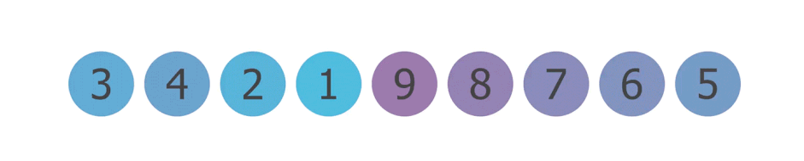
Bubble Sort
Covered in CS2030S!
If first element > second element → Swap
Repeat until no more swaps (worst, n – 1 iterations).
src: https://levelup.gitconnected.com/visual-guide-to-bubble-sort-8dc39914f088?gi=8a0a1f164c12

Slide 4

Bubble Sort
Covered in CS2030S!
Loop Invariant
At the end of iteration $j$, the biggest $j$ items are correctly sorted in the final $j$positions of the array.
Worst Case?
O(n²)
Best Case?
O(n)
Stable?
Yes!

Slide 5
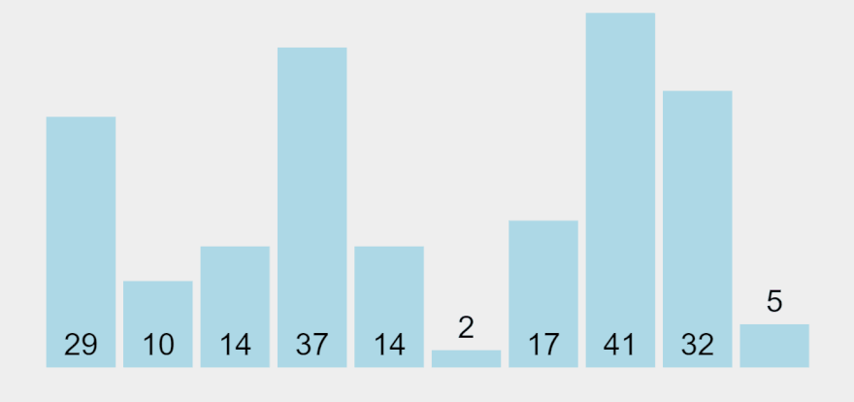
Selection Sort
Covered in CS2030S!
Every iteration, find the minimum element.
Swap first element with the minimum element. Recurse.
src: visualgo

Slide 6

Selection Sort
Covered in CS2030S!
Loop Invariant
At the end of iteration $j$, the smallest $j$ items are correctly sorted in the first $j$ positions of the array.
Worst Case?
O(n²)
Best Case?
O(n²)
Stable?
No!

Slide 7
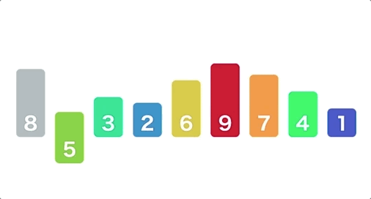
Insertion Sort
Covered in CS2030S!
Every iteration, insert first element in the sorted array.
src: visualgo

Slide 8

Insertion Sort
Covered in CS2030S!
Loop Invariant
At the end of iteration $j$, the first $j$ items are in sorted order.
Worst Case?
O(n²)
Best Case?
O(n)
Stable?
Yes!

Slide 9
Selection Sort vs Insertion Sort
Selection Sort

Slide 10
Selection Sort vs Insertion Sort
Selection Sort
Find minimum

Slide 11
Selection Sort vs Insertion Sort
Selection Sort
Swap with first element
Correct position!

Slide 12
Selection Sort vs Insertion Sort
Selection Sort
Find minimum

Slide 13
Selection Sort vs Insertion Sort
Selection Sort
Swap with first element

Slide 14
Selection Sort vs Insertion Sort
Selection Sort
Find minimum

Slide 15
Selection Sort vs Insertion Sort
Selection Sort
Swap with first element

Slide 16
Selection Sort vs Insertion Sort
Selection Sort
Find minimum

Slide 17
Selection Sort vs Insertion Sort
Selection Sort
Swap with first element

Slide 18
Selection Sort vs Insertion Sort
Selection Sort
Swap with first element

Slide 19
Selection Sort vs Insertion Sort
Insertion Sort

Slide 20
Selection Sort vs Insertion Sort
Insertion Sort
Sorted Region

Slide 21
Selection Sort vs Insertion Sort
Insertion Sort
Take first element, put in sorted order
Sorted Region

Slide 22
Selection Sort vs Insertion Sort
Insertion Sort
Take first element, put in sorted order
Sorted Region

Slide 23
Selection Sort vs Insertion Sort
Insertion Sort
Take first element, put in sorted order
Sorted Region

Slide 24
Selection Sort vs Insertion Sort
Insertion Sort
Take first element, put in sorted order
Sorted Region

Slide 25
Selection Sort vs Insertion Sort
Insertion Sort
Take first element, put in sorted order
Sorted Region

Slide 26
Selection Sort vs Insertion Sort
Insertion Sort
Take first element, put in sorted order
Sorted Region

Slide 27
Selection Sort vs Insertion Sort
Insertion Sort
Take first element, put in sorted order
Sorted Region

Slide 28
Selection Sort vs Insertion Sort
Insertion Sort
Take first element, put in sorted order
Sorted Region

Slide 29
Selection Sort vs Insertion Sort
Insertion Sort
Take first element, put in sorted order
Sorted Region

Slide 30
Selection Sort vs Insertion Sort
Insertion Sort
Take first element, put in sorted order
Sorted Region

Slide 31
Selection Sort vs Insertion Sort
Insertion Sort
Take first element, put in sorted order
Sorted Region

Slide 32
Selection Sort vs Insertion Sort
Insertion Sort
Take first element, put in sorted order
Sorted Region

Slide 33
Selection Sort vs Insertion Sort
Insertion Sort
Take first element, put in sorted order
Sorted Region

Slide 34
Selection Sort vs Insertion Sort
Insertion Sort
Take first element, put in sorted order
Sorted Region

Slide 35
Selection Sort vs Insertion Sort
Insertion Sort
Take first element, put in sorted order
Sorted Region

Slide 36
Merge Sort
Covered in CS2030S!
Divide and Conquer Algorithm
Divide into base cases (pairs), merge them into bigger groups.

Slide 37
Merge Sort
Covered in CS2030S!
Worst Case?
O(n log n)
Best Case?
O(n log n)
Stable?
Yes!

Slide 38
Quick Sort
Covered in CS2030S!
Divide and Conquer Algorithm
Take one element as pivot. Partition based on whether the element is larger or less than pivot.

Slide 39
Quick Sort
Pick pivot, e.g. first element

Slide 40
Quick Sort
Compare elements to pivot

Slide 41
Quick Sort
Compare elements to pivot

Slide 42
Quick Sort
Compare elements to pivot

Slide 43
Quick Sort
Compare elements to pivot

Slide 44
Quick Sort
Compare elements to pivot

Slide 45
Quick Sort
Swap pivot to correct position

Slide 46
Quick Sort
Swap pivot to correct position

Slide 47
Quick Sort
Find Pivot

Slide 48
Quick Sort
Compare elements to pivot

Slide 49
Quick Sort
Swap pivot to correct position

Slide 50
Quick Sort
Find Pivot

Slide 51
Quick Sort
Compare elements to pivot

Slide 52
Quick Sort
Swap pivot to correct position

Slide 53
Quick Sort
Covered in CS2030S!
Loop Invariant
for all i >= high, A[i] > pivot.
for all 1 < j < low, A[j] < pivot.

Slide 54
Stable or Unstable
Covered in CS2030S!
For now, dependent on whether you are swapping with adjacent elements or not.
Bubble, Insertion, Merge → Swap with adjacent
Selection, Quick → Not necessarily adjacent

Slide 55
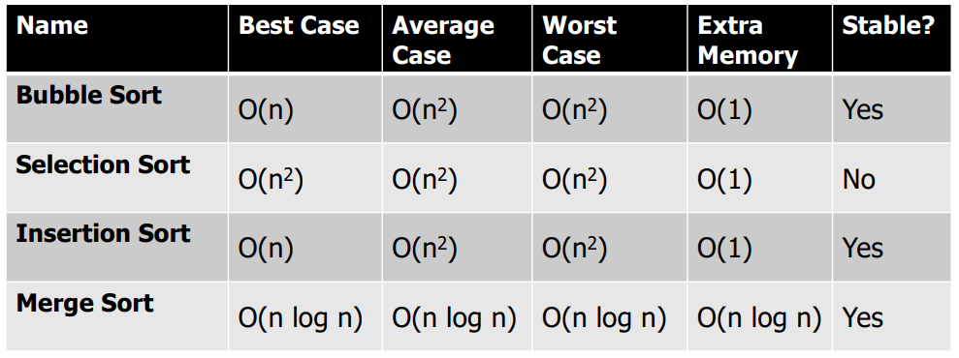
Summary
Covered in CS2030S!

Slide 56
Tutorial Problems
Asymptotic Analysis, Sorting, Stacks and Queues

Slide 57
Before we begin,..
Let’s get to know each other a little better!

Slide 58
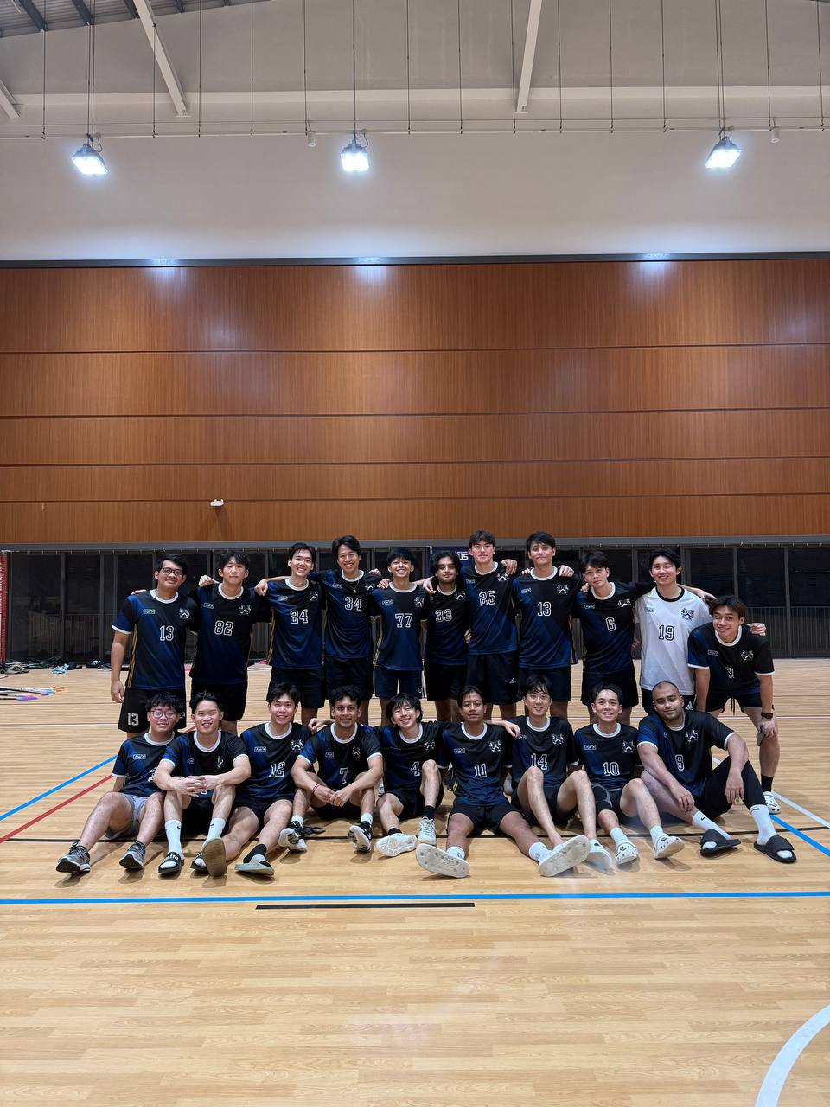
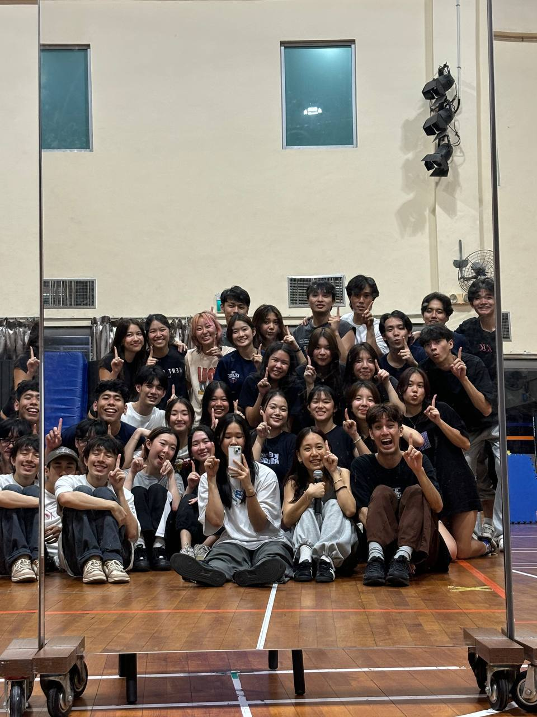

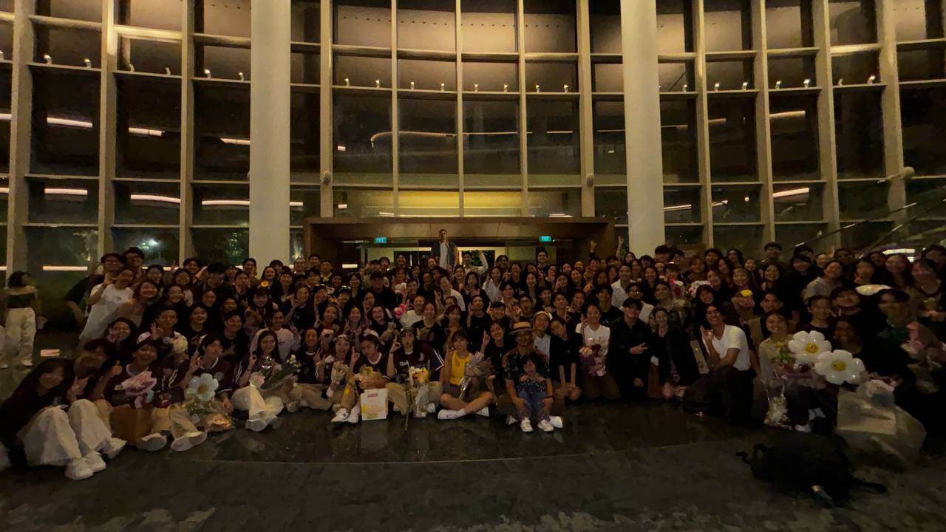
Hi, I’m dom!
Y2 CS (second major in stats) First time TA-ing CS2040S (took in 23/24 Sem 2)

Slide 59
Quick Ice-Breaker!
Introduce your:
Name
One fun fact/hobby/interest
Any NUS CCAs/staying on campus?

Slide 60

Some admin…
Tele channel!

Slide 61
Expectations
From you:
Go through tutorials prior to lesson!
Even if you cannot derive the solution, understand and be familiar with the problem.
Clarify when in doubt, don’t be afraid to ask questions
From me:
Not a DS&A God + first-time TA
BUT, I will do my best to explain things as clearly as possible. If I was not able to explain properly/could not answer your question well, rest assured that I will definitely get back to you.
If I am unable to cover certain things because of time constraint, I will make sure to do my due diligence in the telegram channel.

Slide 62
Problem Set Policy
Unsubmission:
Unsubmission is allowed before PS is graded and only if it is before the deadline
If your submission has critical mistake, I will ask if you want to reattempt (tele message + coursemology comment)
Late Submission:
If you require extension, come and tell me early (before the deadline)
Penalty for no valid reason: 25% to 50% deduction

Slide 63
Discussion Time! (5 mins)
Group 1: Qns 1a, 1b, 1c, 1d
Group 2: Qns 1e, 1f, 1g
Group 3 (3 people): Qns 2a, 2b, 2c
Group 4: Qns 3a, 3b, 3c
Group 5: Qn 3d, 3e
Group 6: Qn 4

Slide 64

1. Time Complexity Analysis
Analyse the following code snippets, find the best asymptotic bound for the time complexity w.r.t. $n$
public int niceFunction(int n) {
for (int i = 0; i < n; i++) {
System.out.println("I am nice!");
}
return 42;
}

Slide 65
1. Time Complexity Analysis
O(n) time. For-loop runs for a total of n iterations.
public int niceFunction(int n) {
for (int i = 0; i < n; i++) {
System.out.println("I am nice!");
}
return 42;
}

Slide 66
1. Time Complexity Analysis
Analyse the following code snippets, find the best asymptotic bound for the time complexity w.r.t. $n$
public int meanFunction(int n) {
if (n == 0)
return 0;
return 2 * meanFunction(n / 2) + niceFunction(n);
}

Slide 67
1. Time Complexity Analysis
Analyse the following code snippets, find the best asymptotic bound for the time complexity w.r.t. $n$
public int meanFunction(int n) {
if (n == 0)
return 0;
return 2 * meanFunction(n / 2) + niceFunction(n);
}
T(n)
T(n / 2)
O(n)

Slide 68
1. Time Complexity Analysis
T(n)
=
T(n / 2)
+
O(n)

Slide 69
1. Time Complexity Analysis
Function Call
Work Done
T(n)
cn
T(n / 2)
cn / 2
T(n / 4)
cn / 4
:
…
T(1)
c

Slide 70
1. Time Complexity Analysis
cn
cn / 2
cn / 4
…
c

Slide 71
1. Time Complexity Analysis
cn
cn / 2
cn / 4
…
c
n
n
Sum of all work done will never exceed 2cn

Slide 72

1. Time Complexity Analysis
cn
cn / 2
cn / 4
…
c
Sum of all work done will never exceed 2cn
$$T\left(n\right)=cn+T\left(\frac{n}{2}\right)$$

Slide 73

1. Time Complexity Analysis
cn
cn / 2
cn / 4
…
c
Sum of all work done will never exceed 2cn
$$T\left(n\right)=cn+\frac{cn}{2}+T\left(\frac{n}{4}\right)$$

Slide 74

1. Time Complexity Analysis
cn
cn / 2
cn / 4
…
c
Sum of all work done will never exceed 2cn
$$T\left(n\right)=cn+\frac{cn}{2}+\frac{cn}{4}+T\left(\frac{n}{8}\right)$$

Slide 75

1. Time Complexity Analysis
cn
cn / 2
cn / 4
…
c
Sum of all work done will never exceed 2cn
$$T\left(n\right)=cn+\frac{cn}{2}+\frac{cn}{4}+…+T\left(1\right)$$

Slide 76

1. Time Complexity Analysis
cn
cn / 2
cn / 4
…
Sum of all work done will never exceed 2cn
$$T\left(n\right)≤ cn+\frac{cn}{2}+\frac{cn}{4}+…$$

Slide 77

1. Time Complexity Analysis
cn
cn / 2
cn / 4
…
Sum of all work done will never exceed 2cn
$$T\left(n\right)≤cn\left(1+\frac{1}{2}+\frac{1}{2^{2}}+…\right)$$

Slide 78

1. Time Complexity Analysis
cn
cn / 2
cn / 4
…
Sum of all work done will never exceed 2cn
$$T\left(n\right)≤cn\left(\frac{1}{1−\frac{1}{2}}\right)$$

Slide 79
1. Time Complexity Analysis
cn
cn / 2
cn / 4
…
c
Sum of all work done will never exceed 2cn
$$T\left(n\right)≤2cn$$

Slide 80
1. Time Complexity Analysis
cn
cn / 2
cn / 4
…
c
Sum of all work done will never exceed 2cn
$$O\left(T\left(n\right)\right)=O\left(n\right)$$

Slide 81
1. Time Complexity Analysis
Analyse the following code snippets, find the best asymptotic bound for the time complexity w.r.t. $n$
public int strangerFunction(int n) {
for (int i = 0; i < n; i++) {
for (int j = 0; j < i; j++) {
System.out.println("Execute order?");
}
}
return 66;
}

Slide 82
1. Time Complexity Analysis
Value of i
1
2
3
4
5
6
…
N - 1
Inner Loop Iterations
1
2
3
4
5
6
…
n - 1

Slide 83

1. Time Complexity Analysis
Inner Loop Iterations
1
+
2
+
3
+
4
+
5
+
6
+
…
n - 1
+
$$\frac{n\left(n−1\right)}{2}$$

Slide 84

1. Time Complexity Analysis
Inner Loop Iterations
1
+
2
+
3
+
4
+
5
+
6
+
…
+
n - 1
$$\frac{1}{2}n^{2}−\frac{1}{2}n$$

Slide 85

1. Time Complexity Analysis
Inner Loop Iterations
1
+
2
+
3
+
4
+
5
+
6
+
…
+
n - 1
$$O\left(n^{2}\right)$$

Slide 86
1. Time Complexity Analysis
Analyse the following code snippets, find the best asymptotic bound for the time complexity w.r.t. $n$
public int suspiciousFunction(int n) {
if (n == 0)
return 2040;
int a = suspiciousFunction(n / 2);
int b = suspiciousFunction(n / 2);
return a + b + niceFunction(n);
}

Slide 87
1. Time Complexity Analysis
Analyse the following code snippets, find the best asymptotic bound for the time complexity w.r.t. $n$
public int suspiciousFunction(int n) {
if (n == 0)
return 2040;
int a = suspiciousFunction(n / 2);
int b = suspiciousFunction(n / 2);
return a + b + niceFunction(n);
}
T(n)
T(n / 2)
T(n / 2)
O(n)

Slide 88
T(n)
=
T(n / 2)
+
T(n / 2)
+
O(n)
Function Call
Work Done
T(n)
cn
T(n / 2)
cn / 2
cn / 2
T(n / 4)
cn / 4
cn / 4
cn / 4
cn / 4
T(n / 8)
cn / 8
cn / 8
cn / 8
cn / 8
cn / 8
cn / 8
cn / 8
cn / 8
:
:
T(1)
c
c
c
c
c
c
c
c
c
c
c
c
c
c
c
c
c
c
c
c
c
c
c
c
c
c
c
c
c
c
c
c
When do we reach 1?

Slide 89

When do we reach 1?
$$\frac{n}{2^{k}}=1$$
$$n=2^{k}$$
$$k=\log_{2}{n}$$

Slide 90
T(n)
=
T(n / 2)
+
T(n / 2)
+
O(n)
Function Call
Work Done
T(n)
cn
T(n / 2)
cn / 2
cn / 2
T(n / 4)
cn / 4
cn / 4
cn / 4
cn / 4
k = log₂ n levels
T(n / 8)
cn / 8
cn / 8
cn / 8
cn / 8
cn / 8
cn / 8
cn / 8
cn / 8
:
:
cn work each level
T(1)
c
c
c
c
c
c
c
c
c
c
c
c
c
c
c
c
c
c
c
c
c
c
c
c
c
c
c
c
c
c
c
c

Slide 91
T(n)
=
T(n / 2)
+
T(n / 2)
+
O(n)
k = log₂ n levels
cn work each level

Slide 92


T(n)
=
T(n / 2)
+
T(n / 2)
+
O(n)
$$cn×\log{n}$$
cn work each level
k = log₂ n levels
$$O(n\log{n})$$

Slide 93
1. Time Complexity Analysis
Analyse the following code snippets, find the best asymptotic bound for the time complexity w.r.t. $n$
public int badFunction(int n) {
if (n <= 0) return 2040;
if (n == 1) return 2040;
return badFunction(n - 1) +
badFunction(n - 2) + 0;
}

Slide 94
1. Time Complexity Analysis
Analyse the following code snippets, find the best asymptotic bound for the time complexity w.r.t. $n$
public int badFunction(int n) {
if (n <= 0) return 2040;
if (n == 1) return 2040;
return badFunction(n - 1) +
badFunction(n - 2) + 0;
}
T(n)
T(n - 1)
T(n - 2)

Slide 95
1. Time Complexity Analysis
T(n)
T(n - 1)
T(n - 2)
O(1)
=
+
+
Familiar?

Slide 96
1. Time Complexity Analysis
T(n)
T(n - 1)
T(n - 2)
O(1)
=
+
+
Familiar? Fibonacci Sequence
F(n)
F(n - 1)
F(n - 2)
=
+

Slide 97
1. Time Complexity Analysis
Proof by Induction
With $F(0) = F(1) = 1$, $T(0) = T(1) = 0$
Suppose n is a non-negative integer s.t. $T\left(i\right)= F\left(i\right)− 1$, $∀i<n$.
T(n)
=
T(n - 1)
+
T(n - 2)
+
1

Slide 98
1. Time Complexity Analysis
Proof by Induction
With $F(0) = F(1) = 1$, $T(0) = T(1) = 0$
Suppose n is a non-negative integer s.t. $T\left(i\right)= F\left(i\right)− 1$, $∀i<n$.
T(n)
=
F(n - 1)
-
1
+
T(n - 2)
+
1

Slide 99
1. Time Complexity Analysis
Proof by Induction
With $F(0) = F(1) = 1$, $T(0) = T(1) = 0$
Suppose n is a non-negative integer s.t. $T\left(i\right)= F\left(i\right)− 1$, $∀i<n$.
T(n)
=
F(n - 1)
-
1
+
F(n - 2)
-
1
+
1

Slide 100
1. Time Complexity Analysis
Proof by Induction
With $F(0) = F(1) = 1$, $T(0) = T(1) = 0$
Suppose n is a non-negative integer s.t. $T\left(i\right)= F\left(i\right)− 1$, $∀i<n$.
T(n)
=
F(n - 1)
+
F(n - 2)
-
1

Slide 101
1. Time Complexity Analysis
Proof by Induction
With $F(0) = F(1) = 1$, $T(0) = T(1) = 0$
Suppose n is a non-negative integer s.t. $T\left(i\right)= F\left(i\right)− 1$, $∀i<n$.
T(n)
=
F(n)
-
1
Fibonacci Sequence F(n) = F(n – 1) + F(n – 2)

Slide 102
1. Time Complexity Analysis
T(n)
=
F(n)
-
1
$$O(T(n)) = O(F(n)) = O\left(φ^{n}\right)$$

Slide 103
1. Time Complexity Analysis
Analyse the following code snippets, find the best asymptotic bound for the time complexity w.r.t. $n$
public int metalGearFunction(int n) {
for (int i = 0; i < n; i++) {
for (int j = 1; j < i; j *= 2) {
System.out.println("!");
}
}
return 0;
}

Slide 104
1. Time Complexity Analysis
Analyse the following code snippets, find the best asymptotic bound for the time complexity w.r.t. $n$
public int metalGearFunction(int n) {
for (int i = 0; i < n; i++) {
for (int j = 1; j < i; j *= 2) {
System.out.println("!");
}
}
return 0;
}

Slide 105
1. Time Complexity Analysis
Inner Loop runs for log(i) iterations
T(n) = log(1) + log(2) + … + log(n)

Slide 106

1. Time Complexity Analysis
Inner Loop runs for log(i) iterations
T(n) = log(1 $∙$ 2 $∙$… $∙$n)
Logarithmic Properties
log(a) + log(b) = log(ab)
log(a) – log(b) = log(a/b)
log(a^{b}) = b log(a)

Slide 107
1. Time Complexity Analysis
Inner Loop runs for log(i) iterations
T(n) = log(n!)

Slide 108

1. Time Complexity Analysis
T(n) = log(n!)
1 $∙$ 2 $∙$ … $∙$ n $≤$ n $∙$ n $∙$ … $∙$n

Slide 109

1. Time Complexity Analysis
T(n) = log(n!)
n! $≤$ n^{n}

Slide 110

1. Time Complexity Analysis
T(n) $≤$n log n
Logarithmic Properties
log(a) + log(b) = log(ab)
log(a) – log(b) = log(a/b)
log(a^{b}) = b log(a)

Slide 111
1. Time Complexity Analysis
O(T(n)) = O(n log n)

Slide 112
1. Time Complexity Analysis
Analyse the following code snippets, find the best asymptotic bound for the time complexity w.r.t. $n$
public String simpleFunction(int n) {
String s = "";
for (int i = 0; i < n; i++) {
s += "?";
}
return s;
}

Slide 113
1. Time Complexity Analysis
Analyse the following code snippets, find the best asymptotic bound for the time complexity w.r.t. $n$
public String simpleFunction(int n) {
String s = "";
for (int i = 0; i < n; i++) {
s += "?";
}
return s;
}
String Concatenation!

Slide 114
1. Time Complexity Analysis
Java concatenates a string by generating a new string instance, then appending the character afterwards
s = “hello”;
s += “!”;
s =
h
e
l
l
o
temp =

Slide 115
1. Time Complexity Analysis
Java concatenates a string by generating a new string instance, then appending the character afterwards
s = “hello”;
s += “!”;
s =
temp =
h
e
l
l
o
!

Slide 116
1. Time Complexity Analysis
Java concatenates a string by generating a new string instance, then appending the character afterwards
s = “hello”;
s += “!”;
s =
temp =
h
e
l
l
o
!
New copy of string takes O(length of string) time

Slide 117
1. Time Complexity Analysis
Analyse the following code snippets, find the best asymptotic bound for the time complexity w.r.t. $n$
public String simpleFunction(int n) {
String s = "";
for (int i = 0; i < n; i++) {
s += "?";
}
return s;
}
O(n) operation, n times
O(n²)

Slide 118
1. Time Complexity Analysis
Follow Up! How to turn this into O(n)?
public String simpleFunction(int n) {
String s = "";
for (int i = 0; i < n; i++) {
s += "?";
}
return s;
}

Slide 119
1. Time Complexity Analysis
Follow Up! StringBuilder object, O(1) concatenation
public String simpleFunction(int n) {
String s = "";
for (int i = 0; i < n; i++) {
s += "?";
}
return s;
}

Slide 120
1. Time Complexity Analysis
Follow Up! StringBuilder object, O(1) concatenation
public String simpleFunction(int n) {
StringBuilder s = "";
for (int i = 0; i < n; i++) {
s += "?";
}
return s;
}
Change String to StringBuilder

Slide 121
1. Time Complexity Analysis
Follow Up! StringBuilder object, O(1) concatenation
public String simpleFunction(int n) {
StringBuilder s = "";
for (int i = 0; i < n; i++) {
s.append("?");
}
return s;
}
Change += to append

Slide 122
1. Time Complexity Analysis
Follow Up! StringBuilder object, O(1) concatenation
public String simpleFunction(int n) {
StringBuilder s = "";
for (int i = 0; i < n; i++) {
s.append("?");
}
return s.toString();
}
Return toString

Slide 123
2. Sorting Review
How would you implement insertion sort recursively? Analyse the time complexity by formulating a recurrence relation.

Slide 124
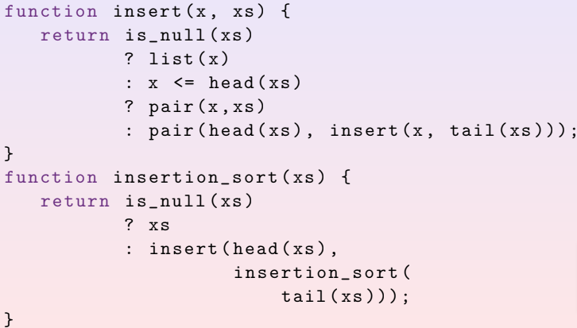
CS1101S:
© A/P Martin Henz, 2021

Slide 125
2. Sorting Review
How would you implement insertion sort recursively? Analyse the time complexity by formulating a recurrence relation.
Retrieve first element in the array, and insert it in the corresponding position.
Recurse to the subarray.

Slide 126
2. Sorting Review
How would you implement insertion sort recursively? Analyse the time complexity by formulating a recurrence relation.
T(n) = T(n – 1) + O(n)
=> Time complexity: O(n²)

Slide 127
2. Sorting Review
Consider an array of pairs (a, b). Your goal is to sort them by a in ascending order. If there are any ties, we break them by sorting b in ascending order. For example, [(2, 1), (1, 4), (1, 3)] should be sorted into [(1, 3), (1, 4), (2, 1)].

Slide 128
2. Sorting Review
You are given 2 sorting functions, which are a MergeSort and a SelectionSort. You can use each sort at most once. How would you sort the pairs? Assume you can only sort by one field at a time.

Slide 129
2. Sorting Review
Merge Sort
Selection Sort
O(n log n)
O(n²)
Stable
Not Stable

Slide 130
2. Sorting Review
1
3
4
2
2
1
3
8
2
5
5
2

Slide 131
2. Sorting Review
Pass 1: Sort by a
1
3
2
1
2
5
3
8
4
2
5
2

Slide 132
2. Sorting Review
Pass 2: Sort by b
2
1
5
2
4
2
1
3
2
5
3
8

Slide 133
2. Sorting Review
Oops! Wrong order!
2
1
5
2
4
2
1
3
2
5
3
8

Slide 134
2. Sorting Review
1
3
4
2
2
1
3
8
2
5
5
2

Slide 135
2. Sorting Review
Pass 1: Sort by b
2
1
5
2
4
2
1
3
2
5
3
8

Slide 136
2. Sorting Review
Pass 2: Sort by a
1
3
2
1
2
5
3
8
4
2
5
2

Slide 137
2. Sorting Review
Sort by b first, before sorting by a.
Which algorithm to sort b, which algo to sort a?

Slide 138
2. Sorting Review
Intermediate step: After sorting by b
2
1
5
2
4
2
1
3
2
5
3
8

Slide 139
2. Sorting Review
Intermediate step: After sorting by b
2
1
2
5
Which algorithm ensures (2, 1) appears before (2, 5)?

Slide 140
2. Sorting Review
Intermediate step: After sorting by b
2
1
2
5
Which algorithm ensures (2, 1) appears before (2, 5)?
Stable Algorithm = MERGE SORT

Slide 141
2. Sorting Review
You are given 2 sorting functions, which are a MergeSort and a SelectionSort. You can use each sort at most once. How would you sort the pairs? Assume you can only sort by one field at a time.
Perform Selection Sort to sort b, then perform Merge Sort to sort a, since Merge Sort is stable.

Slide 142
2. Sorting Review
We have learned how to implement MergeSort recursively. How would you implement MergeSort iteratively? Analyse the time and space complexity.

Slide 143
2. Sorting Review
We have learned how to implement MergeSort recursively. How would you implement MergeSort iteratively? Analyse the time and space complexity.
Idea: Group them into pairs, then group of 4s, then group of 8s, and so on. Sort every group.

Slide 144


2. Sorting Review
Idea: Group them into pairs, then group of 4s, then group of 8s, and so on. Sort every group.
Let each iteration of going through the array be $i$. At iteration $i$, we will sort groups of $2i$ elements.
Invariant: At iteration $i$, groups of $2^{i}$ adjacent elements are correctly sorted.

Slide 145
6
5
8
7
1
4
3
2

Slide 146

Level: $i$ = 1
8
7
1
4
3
2
Array Ptr
6
5
Left Ptr
Right Ptr

Slide 147
Level: $i$ = 1
5
8
7
1
4
3
2
Array Ptr
6
Left Ptr
Right Ptr

Slide 148
Level: $i$ = 1
5
6
8
7
1
4
3
2
Array Ptr
Left Ptr
Right Ptr

Slide 149
Level: $i$ = 1
5
6
8
7
1
4
3
2
Array Ptr
Left Ptr
Right Ptr

Slide 150
Level: $i$ = 1
5
6
1
4
3
2
Array Ptr
8
7
Left Ptr
Right Ptr

Slide 151
Level: $i$ = 1
5
6
7
1
4
3
2
Array Ptr
8
Left Ptr
Right Ptr

Slide 152
Level: $i$ = 1
5
6
7
8
1
4
3
2
Array Ptr
Left Ptr
Right Ptr

Slide 153
Level: $i$ = 1
5
6
7
8
1
4
3
2
Array Ptr
Left Ptr
Right Ptr

Slide 154
Level: $i$ = 1
5
6
7
8
1
4
2
3
Array Ptr
Left Ptr
Right Ptr

Slide 155
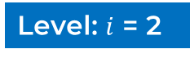
Level: $i$ = 2
5
6
7
8
1
4
2
3
Array Ptr
Left Ptr
Right Ptr

Slide 156
Level: $i$ = 2
1
4
2
3
Array Ptr
5
6
7
8
Left Ptr
Right Ptr

Slide 157
Level: $i$ = 2
5
1
4
2
3
Array Ptr
6
7
8
Left Ptr
Right Ptr

Slide 158
Level: $i$ = 2
5
6
1
4
2
3
Array Ptr
7
8
Right Ptr

Slide 159
Level: $i$ = 2
5
6
7
1
4
2
3
Array Ptr
8
Right Ptr

Slide 160
Level: $i$ = 2
5
6
7
8
1
4
2
3
Array Ptr

Slide 161
Level: $i$ = 2
5
6
7
8
1
2
3
4
Array Ptr

Slide 162
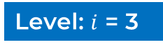
Level: $i$ = 3
5
6
7
8
1
2
3
4
Array Ptr

Slide 163
Level: $i$ = 3
Array Ptr
5
6
7
8
1
2
3
4
Left Ptr
Right Ptr

Slide 164
Level: $i$ = 3
1
Array Ptr
5
6
7
8
2
3
4
Left Ptr
Right Ptr

Slide 165
Level: $i$ = 3
1
2
Array Ptr
5
6
7
8
3
4
Left Ptr
Right Ptr

Slide 166
Level: $i$ = 3
1
2
3
Array Ptr
5
6
7
8
4
Left Ptr
Right Ptr

Slide 167
Level: $i$ = 3
1
2
3
4
Array Ptr
5
6
7
8
Left Ptr

Slide 168
Level: $i$ = 3
1
2
3
4
5
Array Ptr
6
7
8
Left Ptr

Slide 169
Level: $i$ = 3
1
2
3
4
5
6
Array Ptr
7
8
Left Ptr

Slide 170
Level: $i$ = 3
1
2
3
4
5
6
7
Array Ptr
8
Left Ptr

Slide 171
Level: $i$ = 3
1
2
3
4
5
6
7
8
Array Ptr

Slide 172
Level: $i$ = 3
1
2
3
4
5
6
7
8
Array Ptr

Slide 173
Level: $i$ = 3
1
2
3
4
5
6
7
8
Array Ptr
Each iteration takes O(n) operations.
Maximum of $\log_{2}{n}$ iterations.
Running time: O(n log n)

Slide 174

Each iteration takes O(n) operations.
Maximum of $\log_{2}{n}$ iterations.
Iterative-Merge-Sort(A, n)
for $i$ ← 1 to $\log_{2}{n}$:
array_ptr ← 0
while array_ptr not n:
left ← A[array_ptr .. array_ptr + i – 1]
right ← A[array_ptr + i .. array_ptr + 2i – 1]
merge-to-original-array(left, right, array_ptr)
return A

Slide 175
Follow Up!
Space Complexity?
1
2
3
4
5
6
7
8
Array Ptr
Each iteration creates arrays. Total size = n
Maximum of $\log_{2}{n}$ iterations.
Space Complexity: O(n log n)

Slide 176
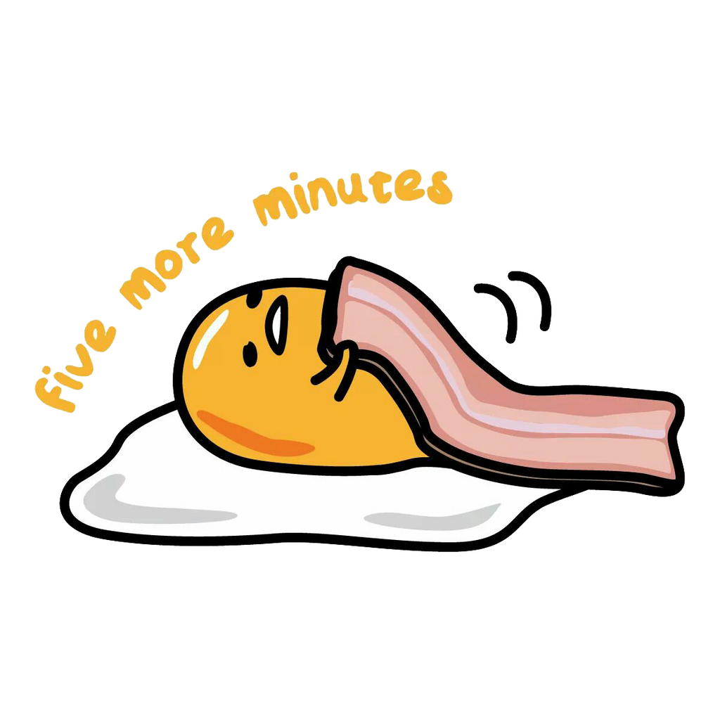
Thread.sleep(300000);
5 Minutes Break! Rise and relax!

Slide 177
3. Queues and Stacks Review
Stack = Last-In → First-Out (LIFO)
stack =
1
2
3
4
5

Slide 178
3. Queues and Stacks Review
Stack = Last-In → First-Out (LIFO)
stack =
1
2
3
4
5
stack.push(1)

Slide 179
3. Queues and Stacks Review
Stack = Last-In → First-Out (LIFO)
stack =
1
2
3
4
5
stack.push(2)

Slide 180
3. Queues and Stacks Review
Stack = Last-In → First-Out (LIFO)
stack =
1
2
3
4
5
stack.push(3)

Slide 181
3. Queues and Stacks Review
Stack = Last-In → First-Out (LIFO)
stack =
1
2
3
4
5
stack.pop()

Slide 182
3. Queues and Stacks Review
Stack = Last-In → First-Out (LIFO)
stack =
1
2
3
4
5
stack.pop()

Slide 183
3. Queues and Stacks Review
Stack = Last-In → First-Out (LIFO)
Return
stack =
1
2
3
4
5
stack.pop()

Slide 184
3. Queues and Stacks Review
Stack = Last-In → First-Out (LIFO)
Return
stack =
1
2
4
3
5
stack.push(4)

Slide 185
3. Queues and Stacks Review
Stack = Last-In → First-Out (LIFO)
1
2
4
Return 4
Does not remove 4 from stack.
3
5
stack =
stack.peek()

Slide 186
Practice!
Stack<Integer> stack = new Stack<Integer>();
stack.push(1);
stack.push(2);
stack.pop();
stack.push(3);
stack.peek();
stack.push(4);
stack.pop();
System.out.println(stack.pop());

Slide 187
Practice!
stack =
1
2
3
4
5
Stack<Integer> stack = new Stack<Integer>();
stack.push(1);
stack.push(2);
stack.pop();
stack.push(3);
stack.peek();
stack.push(4);
stack.pop();
System.out.println(stack.pop());

Slide 188
Practice!
stack =
1
2
3
4
5
Stack<Integer> stack = new Stack<Integer>();
stack.push(1);
stack.push(2);
stack.pop();
stack.push(3);
stack.peek();
stack.push(4);
stack.pop();
System.out.println(stack.pop());

Slide 189
Practice!
stack =
1
2
3
4
5
Stack<Integer> stack = new Stack<Integer>();
stack.push(1);
stack.push(2);
stack.pop();
stack.push(3);
stack.peek();
stack.push(4);
stack.pop();
System.out.println(stack.pop());

Slide 190
Practice!
stack =
1
2
3
4
5
Stack<Integer> stack = new Stack<Integer>();
stack.push(1);
stack.push(2);
stack.pop();
stack.push(3);
stack.peek();
stack.push(4);
stack.pop();
System.out.println(stack.pop());

Slide 191
Practice!
stack =
1
3
2
4
5
Stack<Integer> stack = new Stack<Integer>();
stack.push(1);
stack.push(2);
stack.pop();
stack.push(3);
stack.peek();
stack.push(4);
stack.pop();
System.out.println(stack.pop());

Slide 192
Practice!
stack =
1
3
2
4
5
Stack<Integer> stack = new Stack<Integer>();
stack.push(1);
stack.push(2);
stack.pop();
stack.push(3);
stack.peek();
stack.push(4);
stack.pop();
System.out.println(stack.pop());

Slide 193
Practice!
stack =
1
3
4
2
5
Stack<Integer> stack = new Stack<Integer>();
stack.push(1);
stack.push(2);
stack.pop();
stack.push(3);
stack.peek();
stack.push(4);
stack.pop();
System.out.println(stack.pop());

Slide 194
Practice!
stack =
1
3
2
4
5
Stack<Integer> stack = new Stack<Integer>();
stack.push(1);
stack.push(2);
stack.pop();
stack.push(3);
stack.peek();
stack.push(4);
stack.pop();
System.out.println(stack.pop());

Slide 195
Practice!
stack =
1
3
5
Stack<Integer> stack = new Stack<Integer>();
stack.push(1);
stack.push(2);
stack.pop();
stack.push(3);
stack.peek();
stack.push(4);
stack.pop();
System.out.println(stack.pop());

Slide 196
3. Queues and Stacks Review
Queue = First-In → First-Out (FIFO)
queue =
1
2
3
4
5

Slide 197
3. Queues and Stacks Review
Queue = First-In → First-Out (FIFO)
queue =
1
2
3
4
5
queue.enqueue(1)

Slide 198
3. Queues and Stacks Review
Queue = First-In → First-Out (FIFO)
queue =
1
2
3
4
5
queue.enqueue(2)

Slide 199
3. Queues and Stacks Review
Queue = First-In → First-Out (FIFO)
queue =
1
2
3
4
5
queue.dequeue()

Slide 200
3. Queues and Stacks Review
Queue = First-In → First-Out (FIFO)
1
2
3
Element Shift
4
5
queue =
queue.dequeue()

Slide 201
3. Queues and Stacks Review
Queue = First-In → First-Out (FIFO)
Return
1
2
3
Element Shift
4
5
queue =
queue.dequeue()

Slide 202
3. Queues and Stacks Review
Queue = First-In → First-Out (FIFO)
Return
1
2
3
Element Shift
4
5
queue =
queue.dequeue()

Slide 203
3. Queues and Stacks Review
Queue = First-In → First-Out (FIFO)
Return
1
queue =
2
3
4
5
queue.enqueue(4)

Slide 204
3. Queues and Stacks Review
Queue = First-In → First-Out (FIFO)
Return
1
queue =
2
3
4
5
Return 2
Does not remove 2 from queue.
queue.peek()

Slide 205
3. Queues and Stacks Review
How would you implement a stack and queue with a fixed-size array in Java? (Assume that the number of items in the collections never exceed the array’s capacity.)

Slide 206
3. Queues and Stacks Review
Stack is easy!
Increment and decrement pointer
1
3
2
4
5
6

Slide 207
3. Queues and Stacks Review
Stack is easy!
Increment and decrement pointer
1
3
2
4
5
6
stack.push(1)
Increment pointer by 1

Slide 208
3. Queues and Stacks Review
Stack is easy!
Increment and decrement pointer
1
3
2
4
5
6
stack.peek()
Return arr[pointer – 1]

Slide 209
3. Queues and Stacks Review
Stack is easy!
Increment and decrement pointer
1
3
2
4
5
6
stack.pop()
Return arr[pointer – 1]
Decrement pointer by 1

Slide 210
3. Queues and Stacks Review
Queue is also easy…?
1
3
2
4
5
6

Slide 211
3. Queues and Stacks Review
Queue is also easy…?
Approach 1:
1
3
2
4
5
6
queue.enqueue(1)
Increment pointer by 1

Slide 212
3. Queues and Stacks Review
Queue is also easy…?
Approach 1:
1
2
3
4
5
6
queue.enqueue(2)
Increment pointer by 1

Slide 213
3. Queues and Stacks Review
Queue is also easy…?
Approach 1:
1
2
3
4
5
6
queue.enqueue(5)
Increment pointer by 1

Slide 214
3. Queues and Stacks Review
Queue is also easy…?
Approach 1:
1
2
3
4
5
6
queue. dequeue()
Return element 0.

Slide 215
3. Queues and Stacks Review
Queue is also easy…?
Approach 1:
1
2
3
4
5
6
VERY COSTLY!
One shift of array = O(n)
queue.dequeue()
Return element 0. Shift???

Slide 216
3. Queues and Stacks Review
A faster queue
Approach 2: Two Pointers Method
3
2
4
5
6
Head Ptr
Tail Ptr

Slide 217
3. Queues and Stacks Review
A faster queue
Approach 2: Two Pointers Method
1
3
2
4
5
6
queue.enqueue(1)
Increment tail pointer by 1

Slide 218
3. Queues and Stacks Review
A faster queue
Approach 2: Two Pointers Method
1
2
3
4
5
6
queue.enqueue(5)
Increment tail pointer by 1

Slide 219
3. Queues and Stacks Review
A faster queue
Approach 2: Two Pointers Method
1
2
3
4
5
6
queue.dequeue()
Return value of head pointer.
Increment head pointer by 1

Slide 220
3. Queues and Stacks Review
A faster queue
Approach 2: Two Pointers Method
1
2
3
4
5
6
6
queue.enqueue(6)
Increment tail pointer by 1.

Slide 221
3. Queues and Stacks Review
A faster queue
Approach 2: Two Pointers Method
1
2
3
4
5
6
queue.enqueue(6)
Increment tail pointer by 1.
If exceed, take modulo with size of arr.

Slide 222
3. Queues and Stacks Review
A faster queue
Approach 2: Two Pointers Method
1
2
3
4
5
6
queue.dequeue()
Return value of head pointer.
Increment head pointer by 1

Slide 223
3. Queues and Stacks Review
How can we implement a Deque with a fixed-size array in Java? (Again, assume that the number of items in the collections never exceed the array’s capacity.)
1
3
2
4
5
6

Slide 224
3. Queues and Stacks Review
Same as this approach
2
3
4
5
6
enqueue/dequeue front: modify head ptr
enqueue/dequeue back: modify tail ptr

Slide 225
3. Queues and Stacks Review
What sorts of error handling would we need, and how can we best handle these situations?
1
3
2
4
5
6

Slide 226
3. Queues and Stacks Review
What sorts of error handling would we need, and how can we best handle these situations?
Be mindful of capacity. If full, report invalid.
1
Enqueue / Push
3
2
4
5
6
Dequeue / Pop
Make sure that the stack / queue is not empty.
If empty, report invalid.

Slide 227
3. Queues and Stacks Review
A set of parentheses is said to be balanced as long as every opening parenthesis “(” is closed by a closing parenthesis “)”. Using a stack, determine whether a string of parentheses are balanced
1
3
2
4
5
6

Slide 228
3. Queues and Stacks Review
A set of parentheses is said to be balanced as long as every opening parenthesis “(” is closed by a closing parenthesis “)”. Using a stack, determine whether a string of parentheses are balanced
1
3
2
4
5
6
Idea: Store ( in a stack. Whenever ) encountered,
pop one ( from stack.

Slide 229
Idea: Store ( in a stack. Whenever ) encountered,
pop one ( from stack.
( ( ) ( ) )
stack =
(
(
(
4
5

Slide 230
Idea: Store ( in a stack. Whenever ) encountered,
pop one ( from stack.
( ( ) ( ) )
stack =
(
(
(
4
5

Slide 231
Idea: Store ( in a stack. Whenever ) encountered,
pop one ( from stack.
( ( ) ( ) )
stack =
(
(
(
4
5

Slide 232
Idea: Store ( in a stack. Whenever ) encountered,
pop one ( from stack.
( ( ) ( ) )
stack =
(
(
(
4
5

Slide 233
Idea: Store ( in a stack. Whenever ) encountered,
pop one ( from stack.
( ( ) ( ) )
stack =
(
(
(
4
5

Slide 234
Idea: Store ( in a stack. Whenever ) encountered,
pop one ( from stack.
( ( ) ( ) )
stack =
(
(
(
4
5

Slide 235
Idea: Store ( in a stack. Whenever ) encountered,
pop one ( from stack.
( ( ) ( ) )
stack =
(
(
(
4
5

Slide 236
Idea: Store ( in a stack. Whenever ) encountered,
pop one ( from stack.
( ( ) ( ) )
stack =
(
(
(
4
5

Slide 237
Idea: Store ( in a stack. Whenever ) encountered,
pop one ( from stack.
When is it unbalanced?
“(()))” → Popping from empty stack
1
3
2
4
5
6
“(()()” → Remaining element in stack

Slide 238
3. Queues and Stacks Review
A sequence of opening and closing parentheses of three different types {}, (), and [] is given. Determine whether a given sequence of parentheses is
hyperbalanced.
1
3
2
4
5
6

Slide 239
3. Queues and Stacks Review
Same approach as the previous part.
Modification:
Keep track of the type of parentheses
1
Push
3
2
4
5
6
Pop
Check for type, in addition to checking if the stack is empty

Slide 240
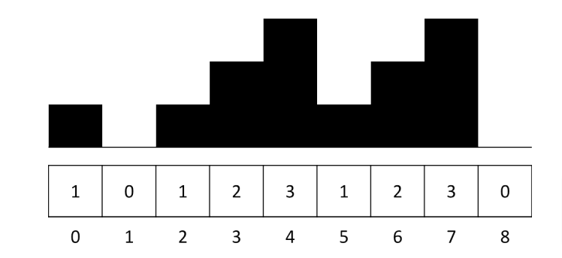

4. Mountain Stack
For each hill i, determine the maximum distance you can see from it.
0
1
2
3
4
5
6
7

Slide 241

4. Mountain Stack
For each hill i, determine the maximum distance you can see from it.
$$∞$$
0
1
2
3
4
5
6
7

Slide 242
4. Mountain Stack
For each hill i, determine the maximum distance you can see from it.
0
$$∞$$
0
1
2
3
4
5
6
7

Slide 243

4. Mountain Stack
For each hill i, determine the maximum distance you can see from it.
$$∞$$
0
$$∞$$
0
1
2
3
4
5
6
7

Slide 244

4. Mountain Stack
For each hill i, determine the maximum distance you can see from it.
$$∞$$
0
$$∞$$
$$∞$$
0
1
2
3
4
5
6
7

Slide 245

4. Mountain Stack
For each hill i, determine the maximum distance you can see from it.
$$∞$$
0
$$∞$$
$$∞$$
$$∞$$
0
1
2
3
4
5
6
7

Slide 246
4. Mountain Stack
For each hill i, determine the maximum distance you can see from it.
$$∞$$
0
$$∞$$
$$∞$$
$$∞$$
0
0
1
2
3
4
5
6
7

Slide 247
4. Mountain Stack
For each hill i, determine the maximum distance you can see from it.
$$∞$$
0
$$∞$$
$$∞$$
$$∞$$
0
1
0
1
2
3
4
5
6
7

Slide 248

4. Mountain Stack
For each hill i, determine the maximum distance you can see from it.
$$∞$$
0
$$∞$$
$$∞$$
$$∞$$
0
1
$$∞$$
0
1
2
3
4
5
6
7

Slide 249
4. Mountain Stack
Model Solution: Monotonic Stack
a.k.a. a stack that is non-decreasing / non-increasing
$$∞$$
0
$$∞$$
$$∞$$
$$∞$$
0
1
$$∞$$
0
1
2
3
4
5
6
7

Slide 250
4. Mountain Stack
Model Solution: Monotonic Stack
a.k.a. a stack that is non-decreasing / non-increasing
Traverse through the array, and store into a stack
If current element >= last element in stack, pop elements in the stack that are smaller than or equal to the current element.
→ Hills that do not obstruct visibility

Slide 251
4. Mountain Stack
If current element >= last element in stack, pop elements in the stack that are smaller than or equal to the current element.
→ Hills that do not obstruct visibility

Slide 252
4. Mountain Stack
If current element >= last element in stack, pop elements in the stack that are smaller than or equal to the current element.
→ Hills that do not obstruct visibility
If current element < last element, do nothing.
If stack is empty, visibility is infinite.
At the end, push the current index onto the stack.

Slide 253

5. Sorting with Queue(s)
Sort a queue using another queue with O(1) additional space.
First Queue
Other Queue

Slide 254
5. Sorting with Queue(s)
Naïve: Selection-sort like
Find minimum, add to the other queue. Return other queue
Optimised: MergeSort-like
Recall iterative merge sort?

Slide 255
5. Sorting with Queue(s)
q1
6
5
8
7
1
4
3
2
q2

Slide 256
5. Sorting with Queue(s)
Check first group of 2
q1
6
5
8
7
1
4
3
2
q2

Slide 257
5. Sorting with Queue(s)
Check first group of 2
Dequeue Q1 → Enqueue Q2
q1
5
8
7
1
4
3
2
q2
6

Slide 258
5. Sorting with Queue(s)
Check first group of 2
Compare first element (peek)
q1
5
8
7
1
4
3
2
q2
6

Slide 259
5. Sorting with Queue(s)
Check first group of 2
Dequeue smaller → Enqueue Q1
q1
8
7
1
4
3
2
5
q2
6

Slide 260
5. Sorting with Queue(s)
Check first group of 2
Dequeue next → Enqueue Q1
q1
8
7
1
4
3
2
5
6
q2

Slide 261
5. Sorting with Queue(s)
Check first group of 2
q1
8
7
1
4
3
2
5
6
q2

Slide 262
5. Sorting with Queue(s)
Check first group of 2
q1
7
1
4
3
2
5
6
q2
8

Slide 263
5. Sorting with Queue(s)
Check first group of 2
q1
1
4
3
2
5
6
7
8
q2

Slide 264
5. Sorting with Queue(s)
Check first group of 2
q1
1
4
3
2
5
6
7
8
q2

Slide 265
5. Sorting with Queue(s)
Check first group of 2
q1
4
3
2
5
6
7
8
q2
1

Slide 266
5. Sorting with Queue(s)
Check first group of 2
q1
3
2
5
6
7
8
1
4
q2

Slide 267
5. Sorting with Queue(s)
Check first group of 2
q1
3
2
5
6
7
8
1
4
q2

Slide 268
5. Sorting with Queue(s)
Check first group of 2
q1
3
5
6
7
8
1
4
q2
2

Slide 269
5. Sorting with Queue(s)
Check first group of 2
q1
5
6
7
8
1
4
2
3
q2

Slide 270
5. Sorting with Queue(s)
Check first group of 4
q1
5
6
7
8
1
4
2
3
q2

Slide 271
5. Sorting with Queue(s)
Check first group of 4
q1
7
8
1
4
2
3
q2
5
6

Slide 272
5. Sorting with Queue(s)
Check first group of 4
q1
7
8
1
4
2
3
5
q2
6

Slide 273
5. Sorting with Queue(s)
Check first group of 4
q1
7
8
1
4
2
3
5
6
q2

Slide 274
5. Sorting with Queue(s)
Check first group of 4
q1
8
1
4
2
3
5
6
7
q2

Slide 275
5. Sorting with Queue(s)
Check first group of 4
q1
1
4
2
3
5
6
7
8
q2

Slide 276
5. Sorting with Queue(s)
Check first group of 4
q1
2
3
5
6
7
8
q2
1
4

Slide 277
5. Sorting with Queue(s)
Check first group of 4
q1
5
6
7
8
1
2
3
4
q2

Slide 278
5. Sorting with Queue(s)
Check first group of 8
q1
5
6
7
8
1
2
3
4
q2

Slide 279
5. Sorting with Queue(s)
Check first group of 8
q1
1
2
3
4
q2
5
6
7
8

Slide 280
5. Sorting with Queue(s)
Check first group of 8
q1
2
3
4
1
q2
5
6
7
8

Slide 281
5. Sorting with Queue(s)
Check first group of 8
q1
3
4
1
2
q2
5
6
7
8

Slide 282
5. Sorting with Queue(s)
Check first group of 8
q1
4
1
2
3
q2
5
6
7
8

Slide 283
5. Sorting with Queue(s)
Check first group of 8
q1
1
2
3
4
q2
5
6
7
8

Slide 284
5. Sorting with Queue(s)
Check first group of 8
q1
1
2
3
4
5
q2
6
7
8

Slide 285
5. Sorting with Queue(s)
Check first group of 8
q1
1
2
3
4
5
6
q2
7
8

Slide 286
5. Sorting with Queue(s)
Check first group of 8
q1
1
2
3
4
5
6
7
q2
8

Slide 287
5. Sorting with Queue(s)
Check first group of 8
q1
1
2
3
4
5
6
7
8
q2

Slide 288

See you next week! Happy Lunar New Year

